Slide 1

Agentic AI, explained
Week of March 2
Jacob Appling

Slide 2
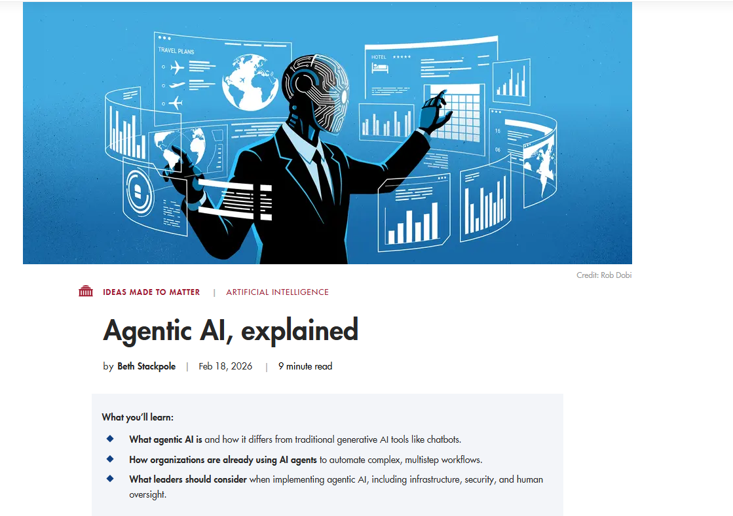
Article #4 (Row 4 via Google Sheet)

Slide 3
Link to the Source
https://mitsloan.mit.edu/ideas-made-to-matter/agentic-ai-explained

Slide 4
Main Findings
The article explains that agentic AI is the next stage in artificial intelligence beyond standard generative AI tools like chatbots. Unlike traditional generative AI, which mainly responds to prompts by producing text, images, or other content, agentic AI can perceive, reason, make decisions, and take actions with limited human supervision. These AI agents can interact with digital systems, use APIs, access information, complete workflows, and in some cases even influence physical operations, such as stopping a conveyor belt in a warehouse when a problem is detected.
A major highlight of the article is that agentic AI is already being adopted across industries. Large companies and software vendors such as Microsoft, Google, Salesforce, and IBM are embedding these capabilities into their platforms, while businesses in banking, retail, and other sectors are exploring uses like fraud detection, customer service automation, financial advising, compliance processes, and shopping assistance. Researchers cited in the article argue that AI agents create value by reducing transaction costs, working continuously without fatigue, processing huge amounts of data quickly, and helping humans make better or faster decisions.
However, the article also stresses that implementation is difficult and risky. Much of the real work is not in prompting the AI, but in data engineering, governance, integration, validation, and stakeholder alignment. The article warns that organizations still do not fully understand the broader societal effects of agentic AI and that there are significant concerns around reliability, cybersecurity, accountability, and ethical decision-making. Overall, the article presents agentic AI as a powerful but still developing technology that requires careful oversight.

Slide 5
Broader implications for society
The broader societal implications of agentic AI are significant because these systems may increasingly perform tasks that were once handled only by humans. This could improve efficiency, lower costs, and increase access to services in areas like finance, healthcare, logistics, and consumer decision-making. AI agents may help people make better-informed choices by analyzing more data than a human could reasonably process, and they may reduce the time and effort required for complicated transactions such as insurance, real estate, or procurement.
At the same time, the article makes clear that these benefits come with serious concerns. If AI agents are given decision-making authority, errors could have major consequences, especially in high-stakes situations like loan approvals, admissions decisions, or legal and financial matters. Society will need stronger governance frameworks, clearer accountability, and more transparent standards for how these systems are used. There is also the risk of organizations adopting agentic AI too quickly without fully understanding how to manage it safely. In that sense, agentic AI could reshape not only work, but also trust, responsibility, and fairness in institutions

Slide 6
Relevance and potential influence on the construction industry
Agentic AI has strong potential to influence the construction industry because construction depends heavily on coordination, scheduling, documentation, procurement, safety monitoring, and communication across many stakeholders. AI agents could help automate multi-step workflows such as reviewing submittals, tracking RFIs, monitoring budgets, coordinating schedules, checking procurement statuses, and flagging inconsistencies across project data. Because construction projects involve many moving parts and large amounts of information, AI agents could improve efficiency by reducing manual administrative work and helping project teams make quicker decisions.
The technology may also have major value in jobsite safety and facilities operations. Similar to the warehouse example in the article, agentic AI could be paired with cameras, sensors, or digital reporting systems to detect unsafe conditions, identify abnormal events, or trigger alerts when risks are present. In design and preconstruction, AI agents could help compare options, review documents, assist with clash detection workflows, and support BIM-based coordination processes. For facility management, agentic AI could eventually assist with predictive maintenance, space management, and ongoing building performance monitoring.
Still, the construction industry would need to be careful about implementation. Construction data is often fragmented, inconsistent, and spread across multiple platforms, which could make integration difficult. In addition, decisions involving safety, cost, and contracts require strong human oversight. For that reason, the biggest influence of agentic AI in construction will likely come from human-AI collaboration rather than fully autonomous decision-making. If implemented carefully, agentic AI could improve productivity, reduce delays, and strengthen project controls, but it will require strong governance, clear accountability, and reliable data systems.

